Slide 1
Introduction to Angular 2+
04/07/2020
by Ammar

Slide 2
Introduction to Angular 2+
One of the most powerful, efficient, and open-source JavaScript frameworks is Angular
Angular is an open source JavaScript framework to build web applications with HTML and JavaScript.
Angular is an application design framework and development platform for creating efficient and sophisticated single-page apps.
It is written entirely in typescript
Some of the important features of Angular
Components It help to build the applications into many modules. This helps in better maintaining the application over a period of time.
Services Services are a set of code that can be shared by different components of an application. So for example if you had a data component that picked data from a database, you could have it as a shared service that could be used across multiple components.
Two-way databinding In two-way databinding, automatic synchronization of data happens between the Model and the View.

Slide 3
Lets set up for angular application
Install Node.js from its official website https://nodejs.org/en/
Install the Angular CLI by this command npm install -g @angular/cli
Creating a project by this command ng new my-app
Run a project by using this command ng serve

Slide 4
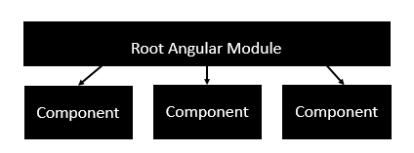
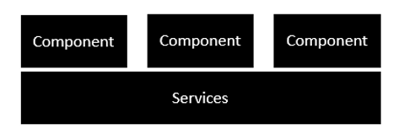
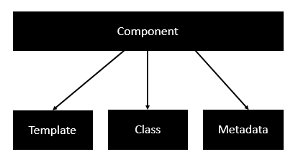
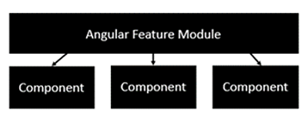
Architecture
Services Each application consists of Components. Each component is a logical boundary of functionality for the application. You need to have layered services, which are used to share the functionality across components.
Components A component consists of
Root Module Each Angular 2 application needs to have one Angular Root Module. Each Angular Root module can then have multiple components to separate the functionality.
Feature Module Each application is made up of feature modules where each module has a separate feature of the application. Each Angular feature module can then have multiple components to separate the functionality.

Slide 5
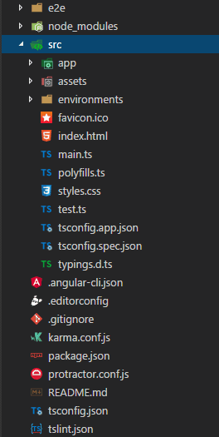
App files explanation
src folder: This is the folder which contains the main code files related to your angular application.
app folder: The app folder contains the files, you have created for app components.
app.component.ts: This is the most important typescript file which includes the view logic behind the component.
app.module.ts: It includes all the dependencies for the website. This file is used to define the needed modules to be imported, the components to be declared and the main component to be bootstrapped.
package.json: This is npm configuration file. It includes details about your website's package dependencies
angular.json: It is very important configuration file related to your angular application. E.g environments on this file (development, production).
assets folder: It contain resource files which are used in the application E.g. images
index.html: This is the entry file.
styles.css: This is a global css file.

Slide 6
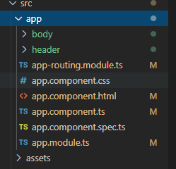
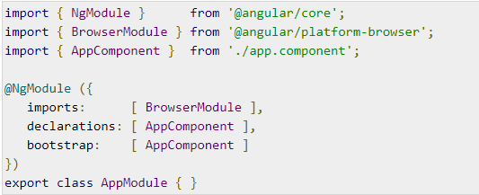
Modules
The import statement is used to import functionality from the existing modules.
The bootstrap option tells Angular which Component to bootstrap in the application.
The import array can be used to import the functionality from other Angular JS modules.

Slide 7
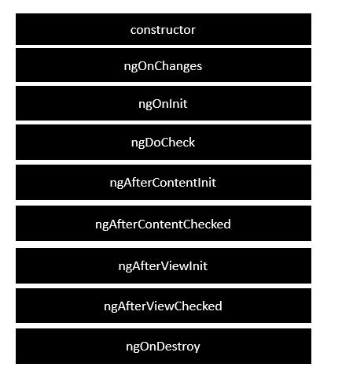
Component lifecycle

Slide 8
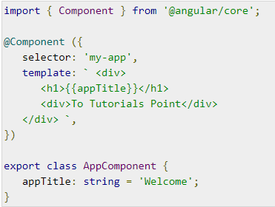
Component
Template Contains the HTML that needs to be rendered in the application.
Class This is like a class defined in any language such as C. This contains properties and methods. It is defined in TypeScript.
Metadata This has the extra data defined for the Angular class. It is defined with a decorator.

Slide 9
Directives
Directives are instructions in the DOM. Directives are js class and declared as @directive. There are 3 directives in Angular.
Component Directives
Structural Directives
Attribute Directives
Component Directives: Component directives are used in main class. They contain the detail of how the component should be processed, instantiated and used at runtime.
Structural Directives: Structural directives start with a * sign. These directives are used to manipulate and change the structure of the DOM elements. For example, *ngIf and *ngFor.
Attribute Directives: Attribute directives are used to change the look and behavior of the DOM elements. For example: ngClass, ngStyle etc.

Slide 10
Databinding
Data binding is a powerful feature of Angular. Angular Databinding is used for communication. It is used to communicate between your TypeScript code (your business logic) and the other component which is shown to the users i.e. HTML layout.
There are two type of data binding:
One-way data binding
One way data binding is a simple one way communication where HTML template is changed when we make changes in Typescript code.
Two-way data binding
In two-way data binding, automatic synchronization of data happens between the Model and the View. Here, change is reflected in both components. Whenever you make changes in the Model, it will be reflected in the View and when you make changes in View, it will be reflected in Model

Slide 11




String Interpolation and Event Binding
In Angular, String interpolation is used to display dynamic data on HTML template (at user end).
In app.component.html In app.component.ts

Slide 12


Pipes
Pipe is used to transform data. It is denoted by symbol |
Pipe takes integers, strings, arrays, and date as input separated with |. It transforms the data in the format as required and displays the same in the browser.

Slide 13
Forms
There are 2 approaches to handle user's input through forms:
Reactive forms
Template-driven forms
Reactive Forms
Reactive forms are more robust.
Reactive forms are more scalable, reusable, and testable.
They are most preferred to use if forms are a key part of your application, or your application is already built using reactive patterns. In both cases, reactive forms are best to use.
Template-driven Forms
Template-driven forms are best if you want to add a simple form to your application. For example: signup form.
Template-driven forms are easy to use in the application but they are not as scalable as Reactive forms.
Template-driven forms are mainly used if your application's requires a very basic form and logic. It can easily be managed in a template.

Slide 14
Reactive and Template-drive forms
Add to your module
import { ReactiveFormsModule } from ‘@angular/forms’;
Add to your component
import { FormGroup, FormControl, Validators } from ‘@angular/forms’;
this.signupForm = new FormGroup(
{
name: new FormControl(null,Validators.required),
email: new FormControl(null,[Validators.email, Validators.required])
});
HTML
<form [formGroup]="signupForm" (ngSubmit)="onSubmit()">
<input type="text" id="username" placeholder="Name" class="form-control" formControlName="name">
Add to your module
import { FormsModule } from '@angular/forms';
<form #f="ngForm" (ngSubmit)="submit(f)">
<input type="text" name="firstName"
[(ngModel)]=" firstName" #firstName="ngModel">
<button [disabled]="!f.valid">Submit</button>

Slide 15
Routing
Import it to app.module.ts
import { AppRoutingModule } from './app-routing.module';
const routes: Routes = [
{ path: ‘home', component: HomeComponent, canActivate: [AuthGuard] },
{ path: login', component: LoginComponent },
{ path: ‘users', component: UserComponent, canActivate: [AuthGuard] },
{ path: ‘user/:id', component: DetailComponent , canActivate: [AuthGuard]},
{ path: "**", component: ErrorComponent }
];
export class AuthGuard implements CanActivate { constructor(private router: Router) { } canActivate(route: ActivatedRouteSnapshot, state: RouterStateSnapshot) {
var user =localStorage.getItem(‘currentUser');
if (user) {
this.router.navigate(['/home']);
return true;
}
this.router.navigate(['/auth/login']);
return false;
}
}

Slide 16
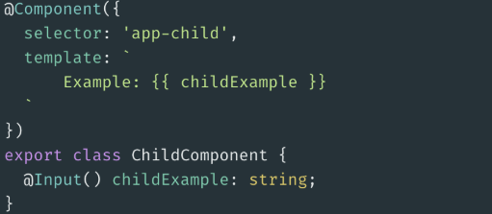
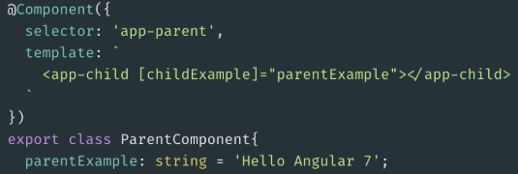
Share Component Data With Other Components
@Input — Property Binding
If you want to pass data from the parent component to the child component, you need to use two things: @Input and property binding.
This gives us the option to add an attribute to the selector (<app-child>) of the child

Slide 17
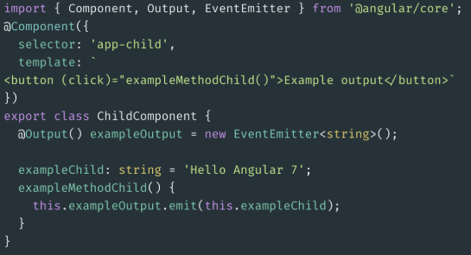
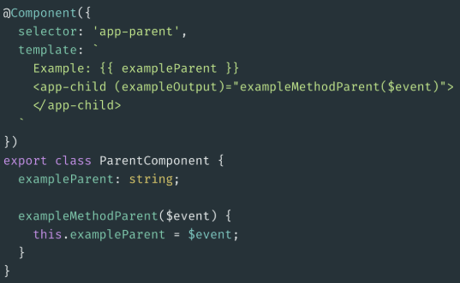
Share Component Data With Other Components
@Output & EventEmitter — Event Binding
With @Output and EventEmitter it’s the other way around. You can pass data back from the child to the parent component
In our parent component Set an event to the child selector (<app-child>). Now, on every button click in the child, we get a text through an event in our parent.

Slide 18
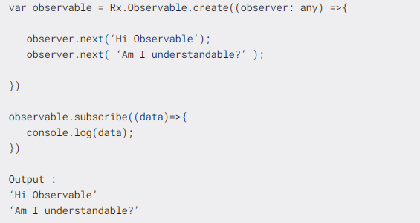
Observables
Observables are also like promises - that are responsible for handling async requests. Observables are a part of the RXJS library. This library introduced Observables and it is recommended technique for event handling, asynchronous programming, and handling multiple values.
Observables are declarative that is, you define a function for publishing values, but it is not executed until a consumer subscribes to it. The subscribed consumer then receives notifications until the function completes, or until they unsubscribe.

Slide 19
References
https://angular.io/docs
https://www.javatpoint.com/angular-7-tutorial
https://www.tutorialspoint.com/angular2/index.htm
https://medium.com/@jinalshah999/reactive-forms-in-angular-a46af57c5f36
https://medium.com/better-programming/angular-7-share-component-data-with-other-components-1b91d6f0b93f
https://www.freecodecamp.org/news/what-are-observables-how-they-are-different-from-promises/

